Slide 1

Java 8 Concepts Lambda Expressions, Annotations
Java Full Stack Program

Slide 2
Java Lambda Expressions
Lambda expression is a new and important feature of Java which was included in Java SE 8. It provides a clear and concise way to represent one method interface using an expression. It is very useful in collection library. It helps to iterate, filter and extract data from collection.
The Lambda expression is used to provide the implementation of an interface which has functional interface. It saves a lot of code. In case of lambda expression, we don't need to define the method again for providing the implementation. Here, we just write the implementation code.
Java lambda expression is treated as a function, so compiler does not create .class file.
Java Full Stack Program

Slide 3
Functional Interface
Lambda expression provides implementation of functional interface. An interface which has only one abstract method is called functional interface. Java provides an anotation @FunctionalInterface, which is used to declare an interface as functional interface.
Why use Lambda Expression
To provide the implementation of Functional interface.
Less coding.
Java Full Stack Program

Slide 4
Java Lambda Expression Syntax
(argument-list) -> {body}
Java lambda expression is consisted of three components.
1) Argument-list: It can be empty or non-empty as well.
2) Arrow-token: It is used to link arguments-list and body of expression.
3) Body: It contains expressions and statements for lambda expression.
No Parameter Syntax
() -> {
//Body of no parameter lambda
}
Java Full Stack Program

Slide 5
One Parameter Syntax
(p1) -> {
//Body of single parameter lambda
}
Two Parameter Syntax
(p1,p2) -> {
//Body of multiple parameter lambda
}
Java Full Stack Program

Slide 6
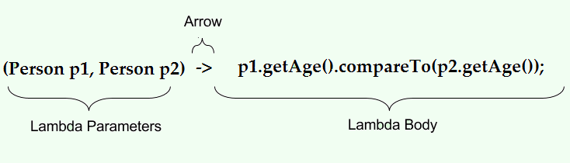
Syntax of Lambda Expression
(TypeA a, TypeB b) -> { a statement or block of code to be execute};
Example
Java Full Stack Program

Slide 7
Syntax of Lambda Expression
There is a semi colon at the end, which means it is a statement/expression.
The arrow token in the middle, divides the complete expression in two parts.
The part at the right is the function body which will be executed for this expression. In the above example case, it was the statement to print an element from the list.
The part at the left is a list of formal parameters to be passed to the function body defined in the right part.
It is not necessary to define the types of the formal parameter.
We can also skip the parenthesis if there is a single formal parameter.
Java Full Stack Program

Slide 8
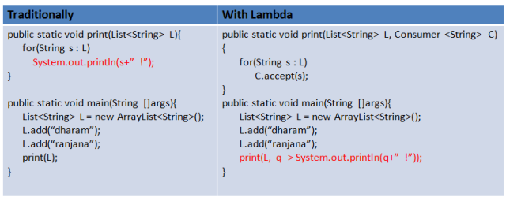
Diffrence between Traditionally used and With Lambda
Java Full Stack Program

Slide 9
More about Lambda Expression
In the previous examples we saw that lambda expressions help us modify the functionality at the caller’s end.
Which means, the caller governs/decides the functionality to be executed in a call.
Lambdas brings the functionality one level above the traditional approach.
This also means that a single method can be used in different context to execute different functionalities.
Basically we are trying to pass the whole function body to a method which just executes the body and returns results.
Java Full Stack Program

Slide 10
Execution of Lambda Expressions
In our code example, we passed the lambda expression to aÂ printÂ method which was expecting a Consumer<String> type argument.This argument is called the target of the Lambda Expression.
The Consumer<T> is an interface defined in the Java library and it has only one abstract method accept. Such interfaces with only one abstract method are called functional interfaces mostly annotated using @FunctionalInterface annotation.
This translates to the following statement:
A method which is written to accept a functional interface as a formal parameter readily accepts a lambda expression. Which means that a lambda expression is an implementation of a functional interface. And because we didn’t have a name for the lambda expression, this means that it is an anonymous implementation for the functional interface.
To be more precise, the lambda expression becomes the body of the only function of a functional interface. Hence, it is a compact representation for the single method classes or interfaces.
Which again translates to, the statement (String q) -> System.out.println(q+” ! ”) is an implemented version of the accept method of the Consumer class. So, the argument to the apply method is a string q and the body of the apply method is the System.out.println(q+” ! ”) statement.
Java Full Stack Program

Slide 11
Lambda use cases in Java
Lambda expressions are used to achieve the functionality of an anonymous classÂ without the cluttered implementation. They are great for repeating simple behaviors that could be used in multiple areas across the program, for example, to add two values without changing the input data.
These properties make lambda especially useful for functional proramming styles in Java. Before Java 8, Java struggled to find tools to meet all the principles of functional programming.
Functional programming has 5 key principles:
Pure functions: Functions that operate independently from the state outside the function and contain only operations that are essential to find the output.
Immutability: Inputs are referenced, not modified. Functions should avoid complex conditional behavior. In general, all functions should return the same value regardless of how many times it is called.
First-class functions: Functions are treated the same as any other value. You can populate arrays with functions, pass functions as parameters, etc.
Higher-order functions: Higher-order functions either one or more functions as parameters or return a function. These are essential to creating complex behaviors with functional programming.
Function Composition: Multiple simple functions can be strung together in different orders to create complex functions. Simple functions complete a single step that may be shared across multiple tasks, while complex functions complete an entire task.
Java Full Stack Program

Slide 12
Lambda expressions help us achieve pure functions, immutability, and first-class functions principles in Java.
Lambda functions are pure because they do not rely on a specific class scope. They are immutable because they reference the passed parameter but do not modify the parameter’s value to reach their result. Finally, they’re first-class functions because they can be anonymous and passed to other functions.
Lambda expressions are also used as event listeners and callback functions in non-functional programs because of their class independence.
Why do we need lambdas?
The key reason for adding lambdas to the Java programming language is the need to evolve the JDK and in particular the JDK's collection framework.
The traditional API design of the Java collections in package java.util renders certain optimizations impossible. At the same time, these optimizations are badly needed.
Considering the current and future hardware architecture that we design our software for, we need support for increased parallelism and improved data locality
Java Full Stack Program

Slide 13
Examples of Java Lambda Expressions
Some of the examples of using Lambda Expressions are as follows:
1) Getting String length
(String str) -> str.length();
This takes a single string parameter. This method also returns an integer value. However, the returned type is not visible because it is not declared anywhere in the declaration.
It is used internally and is based on the lambda body. If lambda only has one statement that returns a value, it becomes a return type.
Java Full Stack Program

Slide 14
2) Employee Rating Check
(Employee emp) -> emp.getGrade().equals("A");
It takes one parameter of the type Employee and returns a boolean value. Lambda Body checks for a “A” grade and returns true or false.
3) Concatenate two Strings and Print Output
(String str1, String str2) -> {
String output = str1.concat(str2);
System.out.println("Concantenated string "+output);
}
It accepts two String parameters and does not return anything. That implies that the return type is void. The body contains two statements that concatenate the output string and print it.
Java Full Stack Program

Slide 15
Uses of Java Lambda Expressions
The different uses and implementation of Java Lambda Expressions are as follows:
Java Lambda Expression: No Parameter
Java Lambda Expression: Single Parameter
Java Lambda Expression: Multiple Parameters
Java Lambda Expression: With or Without Return Keyword
Java Lambda Expression: Foreach Loop
Java Lambda Expression: Multiple Statements
Java Lambda Expression: Creating Thread
Java Lambda Expression: Comparator
Java Lambda Expression: Filter Collection Data
Java Lambda Expression: Event Listener
Java Full Stack Program

Slide 16
Benefits of Java Lambda Expressions
The benefits of Lambda Expressions are as follows:
1) More Concise Syntax
Lambda expressions enable you to write fewer lines of code than an anonymous class to implement a functional interface.
A) Implementing the Print interface using a nested class:
interface Print {
void print(String message);
}
public class MainClass {
public static void main(String args[]) {
//using nested class
Print myNestedPrinter = new Print(){
public void print(String x) {
System.out.println(x);
}
};
//using lambda
Print myPrinter = x -> System.out.println(x);
myNestedPrinter.print("Hello nested classes");
myPrinter.print("Hello lambdas!");
}
}
Java Full Stack Program

Slide 17
B) Implementing the Print interface using Java Lambda Expression
interface MathOp {
int operate(int a, int b);
}
public class MainClass {
public static void printResults(int x) {
System.out.println(x);
}
public static void main(String args[]) {
MathOp add = (a, b) -> {
return a + b;
};
printResults(add.operate(2, 2));
//prints 4
}
}
The above example shows the advantage of using a Java lambda expression over an anonymous class. You must explicitly create a new instance of the Print interface and implement its print method when using the anonymous class. This requires four more lines of code than using a Lambda expression.
Java Full Stack Program

Slide 18
2) Easier to work with Collections
Lambdas provide a much more elegant way of working with collections. For example:
import java.util.*;
public class MainClass {
public static void main(String args[]) {
List<Character> list = new ArrayList<Character>();
list.add('a');
list.add('b');
list.add('c');
list.forEach(x -> System.out.println(x));
}
}
A Lambda expression x -> System.out.println(x) that is applied to each element in the collection using the for Each method.
When used with the Streams API, this is considered an internal iteration and may have some performance implications. More specifically, parallel processing is simple to implement with internal iterations because they offload iteration management to a process. This is in contrast to external iterations, which completely control how the iteration is implemented.
Java Full Stack Program

Slide 19
Limitations of Java Lambda Expressions
In Java, Lambda expressions (and anonymous classes) can only access the final (or effectively final) variables of the enclosing scope.
For example:
void fn()
{
int myVar = 42;
Supplier<Integer> lambdaFun = () -> myVar; // error
myVar++;
System.out.println(lambdaFun.get());
}
Java Full Stack Program

Slide 20
Annotations in Java
Annotations in Java provide additional information to the compiler and JVM. An annotation is a tag representing metadata about classes, interfaces, variables, methods, or fields. Annotations do not impact the execution of the code that they annotate.
Some of the characteristics of annotations are:
Begin with ‘@’
Do not alter the execution of the program
Provide supplemental information and help to link metadata with elements of a program such as classes, variables, constructs, methods, etc.
Are different from comments since they can affect how the program is treated by the compiler
Java Full Stack Program

Slide 21
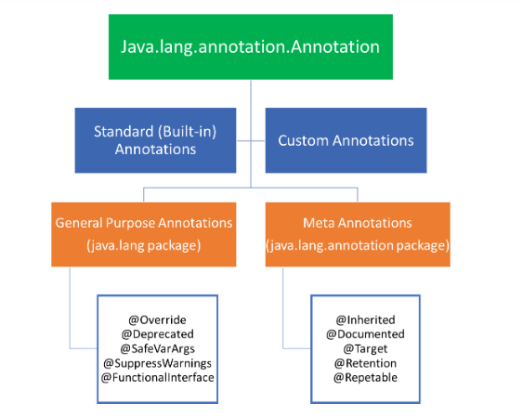
Hierarchy of Annotations in Java
Java Full Stack Program

Slide 22
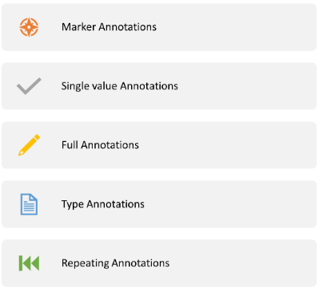
Categories of Annotations
Annotations can be categorized broadly into 5 categories:
Java Full Stack Program

Slide 23
Category 1: Marker Annotations
The marker annotation is used to mark a declaration. It does not include any members or data. Only the presence of a marker annotation as an annotation is sufficient. An example of Marker Annotation is @Override
Example
@TestAnnotation()
Java Full Stack Program

Slide 24
Category 2: Single value Annotations
A single value annotation consists of a single member only. This annotation allows a shorthand form to specify the value of the member. There is no need to specify the name of the member, only the value of the member has to be specified. There must, however, be a value for the name of the member in order to use this category of annotation.
Example
@interface AnnotationName
{
Int value();
}
@interface AnnotationName{
int value() default 0;
}
To apply single value annotation, use
@AnnotationName(value=6)
Any value can be assigned.
Java Full Stack Program

Slide 25
Category 3: Full Annotations
Full Annotations include multiple data members, values, names, and pairs.
Example
@TestAnnotation(owner= ”Ravi”, value= ”Class ”)
Category 4: Type Annotations
As the name suggests, Type Annotations are applied at any place where a type is being used. For instance, the return type of a method can be annotated. Type Annotations are declared with @Target Annotation
Example
// Java Program to Demonstrate Type Annotation
// Importing required classes
import java.lang.annotation.ElementType;
import java.lang.annotation.Target;
// Using target annotation to annotate a type
Java Full Stack Program

Slide 26
Types of Annotations
Annotation 1: @Deprecated
The @Deprecated annotation is used to indicate that the class, field, or method marked is no longer in use and has been replaced by a newer form. Whenever a class, field, or method marked with the @Deprecated annotation is used, the compiler gives a warning message that a deprecated class, field, or method is used. When an element has been deprecated, the Javadoc tag @deprecated tag must be used. There is a difference between the @deprecated tag and @Deprecated annotation. While the @deprecated tag is used for documentation, the @Deprecated annotation is used for runtime reflection.
Java Full Stack Program

Slide 27
Annotation 2: @Override
@Override is a marker annotation that can only be used on methods. A method that is annotated with @Override must override a method from the superclass. A compile-time error occurs if the method does not override the method from the superclass. This ensures that the superclass method is overridden and not overloaded. The code becomes more readable and maintenance issues can be avoided.
Annotation 3: @SuppressWarnings
@SuppressWarnings is used to inform the compiler to suppress the specified compiler warnings. This is done by specifying the warnings to be suppressed by specific names. It can be applied to any type of declaration. There are two categories under which Java groups warnings - deprecated and unchecked. When a legacy code interfaces with a code that uses generics, an unchecked warning is generated.
Java Full Stack Program

Slide 28
Annotation 4: @Documented
@Documented is a marker interface that specifies to a tool that a particular annotation has to be documented. Annotations are not included in the ‘Javadoc’ comments. By using @Documented annotation in the code, tools like Javadoc can process and include the annotated type in the generated document.
Annotation 5: @Target
@Target is used as an annotation to another annotation. The @Target annotation takes only one argument and this argument should be a constant value from the ElementType enumeration.
@Target({ElementType.FIELD, ElementType.LOCAL_VARIABLE})
Java Full Stack Program

Slide 29
Annotation 6: @Inherited
@Inherited annotation is a marker annotation that is only used on annotation declaration. Only the annotations that are used on class declarations are affected by it. @Inherited causes the subclass to inherit the annotation from a superclass. Hence, when there is a request for a specific annotation to a subclass and it is not present in the subclass, the superclass is checked. If the annotation is present in the superclass and it is annotated with @Inherited, the annotation is returned.
Annotation 7: User-defined (Custom)
To annotate program elements, i.e. variables, constructors, methods, etc. user-defined annotations can be used. The user-defined annotations can be applied to the elements Ii.e. variables, constructors, classes, methods) just before their declaration.
Annotations are created by using @interface and are followed by the annotation name. An annotation can also have elements. They appear as methods but the implementation should not be provided for these elements. All the annotations extend java.lang.annotation.Annotation interface. The annotations cannot include the extended clause.
Java Full Stack Program

Slide 30
Use of Annotations
Annotations are used for the following purposes:
Instructions to the compiler: There are three types of built-in annotations @Deprecated, @Override, @SuppressWarnings that can be used to give instructions to the compiler, detect errors, and suppress warnings. For example, @Override annotation can be used to instruct the compiler to denote that the annotated method is overriding the method.
Compile-time Instructions: Software build tools can generate code, XML files, and more by using the compile-time instructions that the annotations provide.
Runtime Instructions: Annotations can also be defined to provide instructions to the program at runtime. These annotations can be accessed using Java Reflection.
Java Full Stack Program

Slide 31
THANK YOU
Java Full Stack Program

